Slide 1
CSE3024 - Web Mining
Course summary
Dr. A. Bhuvaneswari
Assistant Professor (Sr. Grade)
VIT, Chennai

Slide 2
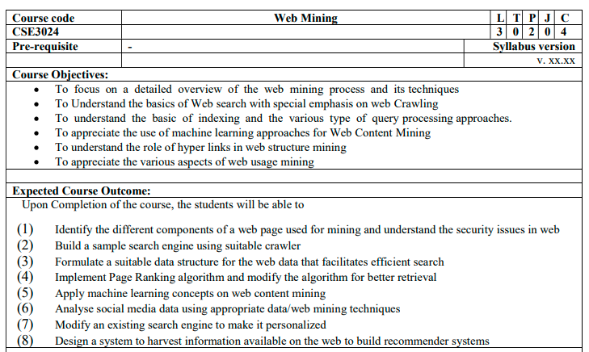

Slide 3
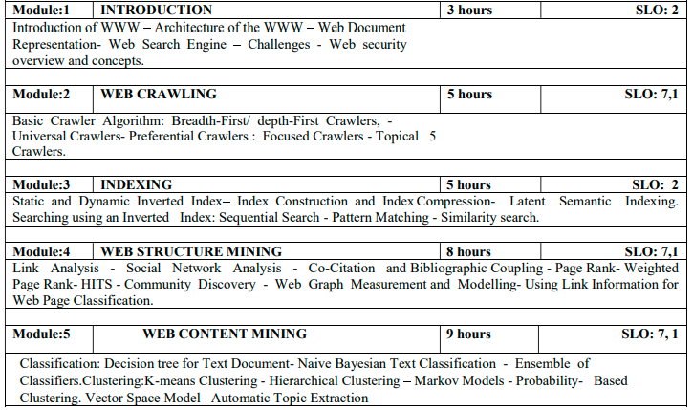

Slide 4
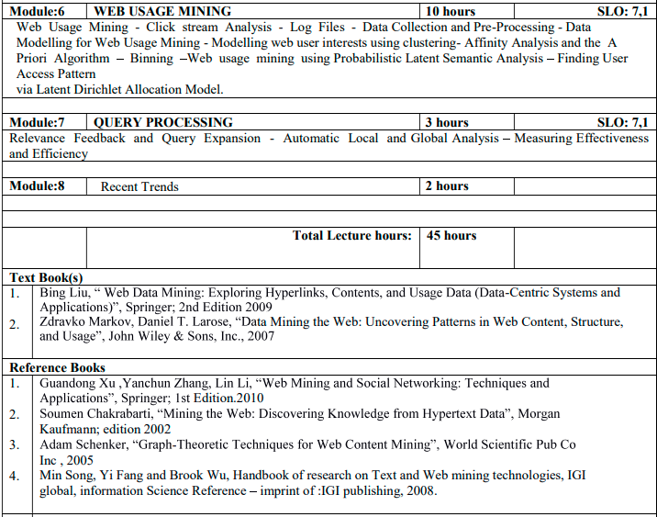

Slide 5
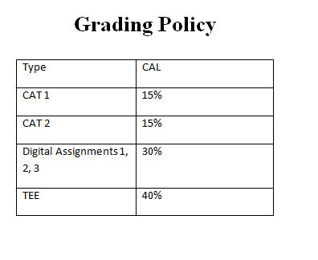

Slide 6
What is Web Mining
From its very beginning, the potential of extracting valuable knowledge from the Web has been quite evident
Web mining is the collection of technologies to fulfill this potential
But, why is this important and why is it more relevant than at any other time during the history of the Web?
Web Mining Definition
application of data mining and machine learning techniques to extract useful knowledge from the content, structure, and usage of Web resources.

Slide 7
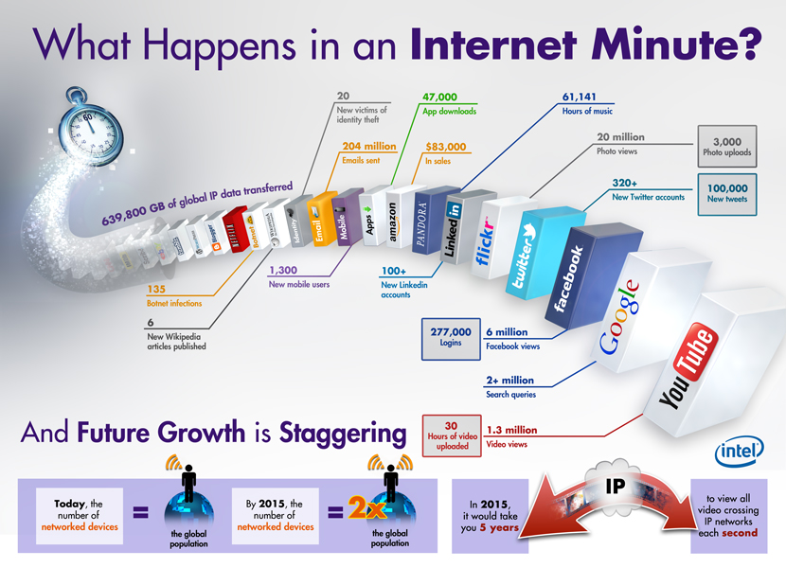
Source: Intel, 2012
Notes:
I discussed this picture in my overview of data mining and knowledge discovery. But, it’s worth pondering it again. It illustrates the staggering amounts of data transmitted across the internet in one minute. Much of this data is generated as a result of user interactions with a variety of online applications and resources on the Web. In contrast to early days of the Web when resources were primarily Web pages downloaded while browsing the Web. Now, users rely on interactive two-way communication with applications. Users are also able to create and share content or resources on social or information networks.
What do all of these systems and applications have in common? They all depend on the ability to serve the most relevant and useful information to end users. But, their ability to effectively serve their users depends on how successfully they mine, analyze, and leverage their data.

Slide 8
Background
WWW: invented in 1989 by Tim Berners-Lee (CERN)
Distributed Hypertext System
HyperText Transfer Protocol (HTTP),
HyperText Markup Language (HTML)
Universal Resource Locator (URL)
Mosaic and Netscape Browsers (1994)
Internet Explorer (1995)

Slide 9
Search Engines
ARPANET (1969)
TCP/IP by Vinton Cerf and Bob Kahn (1973)
Internet (1982)
Search Engines
Excite (1993)
Yahoo! (1994)
Google (1998)
W3C (1994)
Bubble burst in 2001

Slide 10
Web Data Mining
Web is huge
structured tables, semistructured pages, unstructured texts, and multimedia files (images, audios, and videos)
Information on the Web is heterogeneous
Web is linked
Hyperlinks
Authoritative pages

Slide 11
What is Web?
Web is noisy
main content
businesses and commerce
recommender systems
Web is dynamic
Web is a virtual society
opinion mining and social network analysis

Slide 12
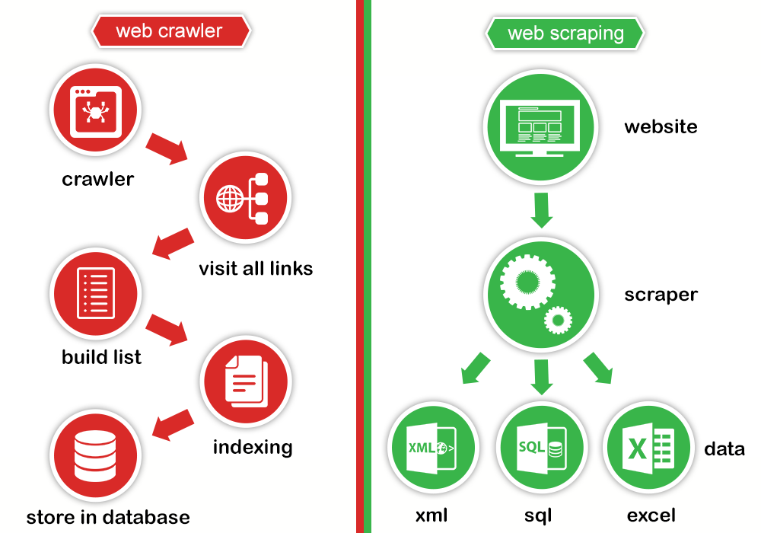

Slide 13
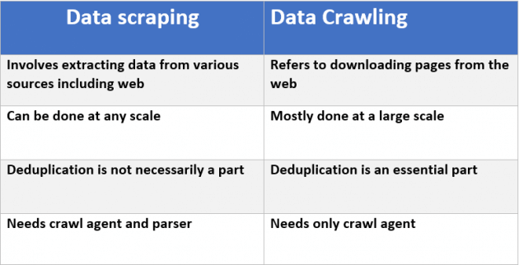

Slide 14
What’s needed to succeed in the new world of “big data” Internet?
Leveraging big data
Many of these applications manage, clean, and preprocess integrate often unstructured data from across many channels
Biggest challenge is in data distillation and preprocessing
Effective use of data mining and analytics
No longer just a luxury but an integral part of systems
Especially important to leverage and effectively use user behavior and social data
Real-time deployment of models
Needed for effective delivery of relevant, targeted, personalized content
Especially important on the Web: Predictive User Modeling

Slide 15
Predictive User Modeling
The Problem
Dynamically serve customized content (ads, products, deals, recommendations, etc.) to users based on their profiles, preferences, or expected interests
Why we need it?
Information spaces are becoming much more complex for user to navigate (huge online repositories, social networks, mobile applications, blogs, ….)
For businesses: need to grow customer loyalty / increase sales
Industry Research: successful online retailers are generating as much as 35% of their business from recommendations/targeted content delivery
Notes:
This is a topic that we come back to many times because it is the corner stone of many of today’s intelligent Web-based applications.

Slide 16
Types of Web Mining
Web Mining
Web Content
Mining
Web Usage
Mining
Web Structure
Mining
Notes:
Let’s get back to our discussion of Web mining and its applications.
Web mining can be categorized into three separate areas based on the type of data that is being mined or analyzed.

Slide 17
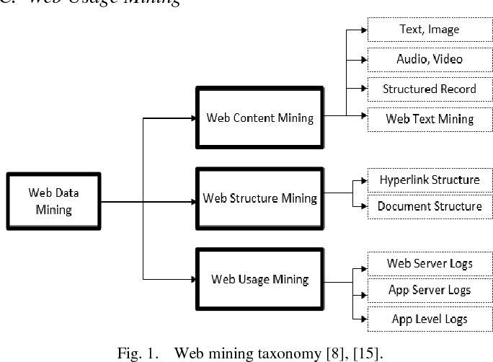

Slide 18
Types of Web Mining
Web Mining
Web Content
Mining
Web Usage
Mining
Web Structure
Mining
Extracting useful knowledge from the contents of Web documents or other semantic information about Web resources

Slide 19
Types of Web Mining
Web Mining
Web Content
Mining
Web Usage
Mining
Web Structure
Mining
Content data may consist of text, images, audio, video, structured records from lists and tables, or item attributes from backend databases.

Slide 20
Types of Web Mining
Web Mining
Web Content
Mining
Web Usage
Mining
Web Structure
Mining
Applications:
document clustering or categorization
topic identification / tracking
concept discovery
focused crawling
content-based personalization
intelligent search tools

Slide 21
Types of Web Mining
Web Mining
Web Content
Mining
Web Usage
Mining
Web Structure
Mining
Extracting interesting patterns from user interactions with resources on one or more Web sites

Slide 22
Types of Web Mining
Web Mining
Web Content
Mining
Web Usage
Mining
Web Structure
Mining
Applications:
user and customer behavior modeling
Web site optimization
e-customer relationship management
Web marketing
targeted advertising
recommender systems

Slide 23
Types of Web Mining
Web Mining
Web Content
Mining
Web Usage
Mining
Web Structure
Mining
Discovering useful patterns from the hyperlink structure connecting Web sites or Web resources

Slide 24
Types of Web Mining
Web Mining
Web Content
Mining
Web Usage
Mining
Web Structure
Mining
Data sources include the explicit hyperlink between documents, or implicit links among objects (e.g., two objects being “tagged” using the same keyword).

Slide 25
Types of Web Mining
Web Mining
Web Content
Mining
Web Usage
Mining
Web Structure
Mining
Applications:
document retrieval and ranking (e.g., Google)
discovery of “hubs” and “authorities”
discovery of Web communities
social network analysis

Slide 26
Web Content Mining :: common approaches and applications
Basic notion: document similarity
Most Web content mining and information retrieval applications involve measuring similarity among two or more documents
Vector representation facilitates similarity computations using vector-space operations (such as Cosine of the angle between two vectors)
Examples
Search engines: measure the similarity between a query (represented as a vector) and the indexed document vectors to return a ranked list of relevant documents
Document clustering: group documents based on similarity or dissimilarity (distance) among them
Document categorization: measure the similarity of a new document to be classified with representations of existing categories (such as the mean vector representing a group of document vectors)
Personalization: recommend documents or items based their similarity to a representation of the user’s profile (may be a term vector representing concepts or terms of interest to the user)

Slide 27
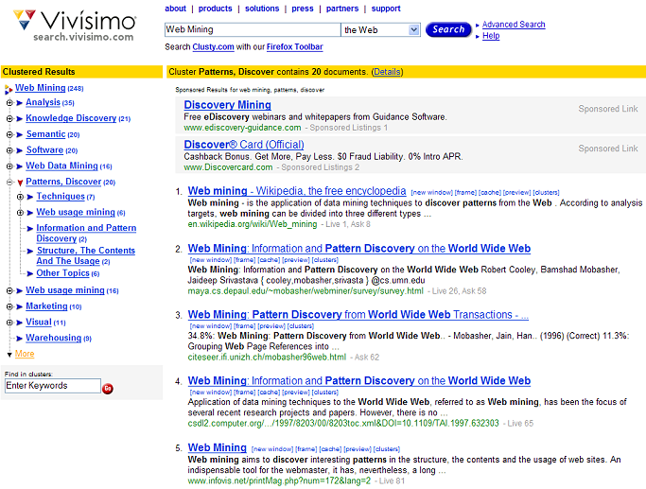
Web Content Mining :: example – clustered search results
Can drill down within clusters to view sub-topics or to view the relevant subset of results

Slide 28
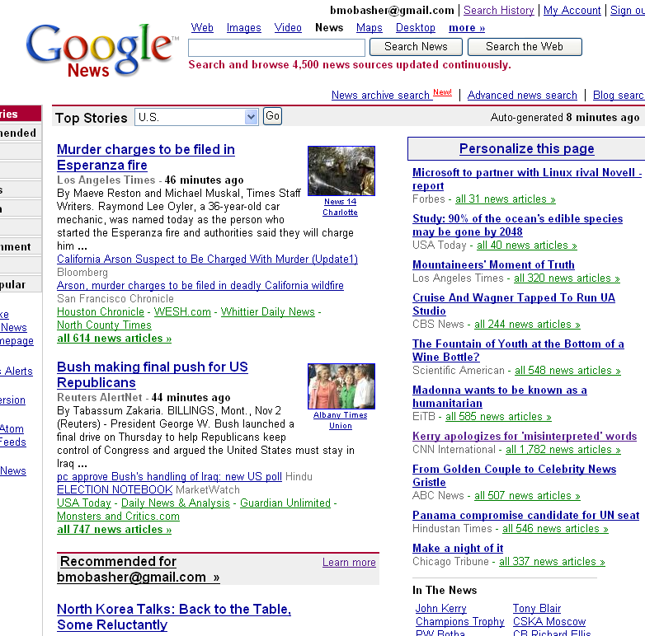
Web Content Mining :: example – personalized content delivery
Google's personalized news is an example of a content-based recommender system which recommends items (in part) based on the similarity of their content to a user’s profile (gathered from search and click history)

Slide 29
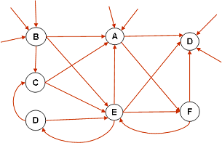
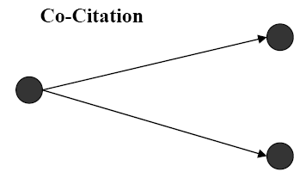
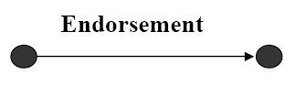
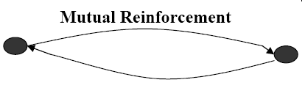
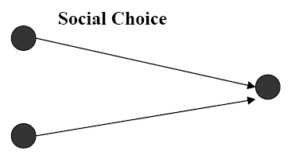
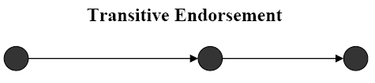
Web Structure Mining :: graph structures on the Web
The structure of a typical Web graph
Web pages as nodes
hyperlinks as edges connecting two related pages
Hyperlink Analysis
Hyperlinks can serve as a tool for pure navigation
But, often they are used to point to pages with authority on the same topic as the source page (similar to a citation in a publication)
Some interesting Web structures *

Slide 30
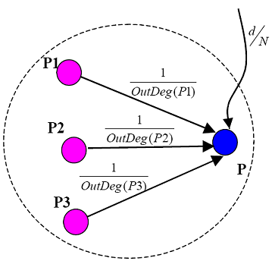
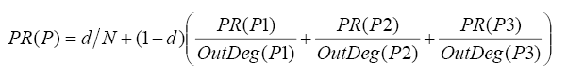
Web Structure Mining :: example – Google’s PageRank algorithm
Basic idea:
Rank of a page depends on the ranks of pages pointing to it
Out Degree of page is the number of edges pointing away from it – used to compute the contribution of the page to those to which it points
The final PageRank value represents the probability that a random surfer will reach the page
d is the prob. that a random surfer chooses the page directly rather than getting there via navigation
Illustration of PageRank propagation

Slide 31
Web Structure Mining :: example – Hubs and Authorities
Basic idea
Authority comes from in-edges
Being a hub comes from out-edges
Mutually re-enforcing relationship
A good authority is a page that is pointed to by many good hubs.
A good hub is a page that points to many good authorities.
Together they tend to form a bipartite graph
This idea can be used to discover authoritative pages related to a topic
HITS algorithm – Hypertext Induced Topic Search
Hubs
Authorities

Slide 32
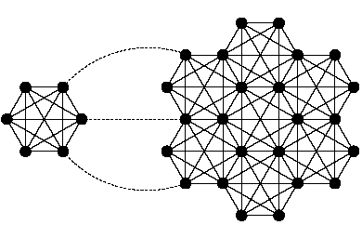
Web Structure Mining :: example – online communities
Community 2
Basic idea
Web communities are collections of Web pages such that each member node has more hyperlinks (in either direction) within the community than outside the community.
Typical approach: Maximal-flow model *
Ex: separate the two subgraphs with any choice of source node (left subgraph) and sink node (right subgraph), removing the three dashed links
Community 1
Source
node
sink
* Source: G. Flake, et al. “Self-Organization and Identification of Web Communities”, IEEE Computer, Vol. 35, No. 3, pp. 66-71, March 2002 .

Slide 33
Web Usage Mining
The Problem: analyze Web navigational data to
Find how the Web site is used by Web users
Understand the behavior of different user segments
Predict how users will behave in the future
Target relevant or interesting information to individual or groups of users
Increase sales, profit, loyalty, etc.
Challenge
Quantitatively capture Web users’ common interests and characterize their underlying tasks

Slide 34
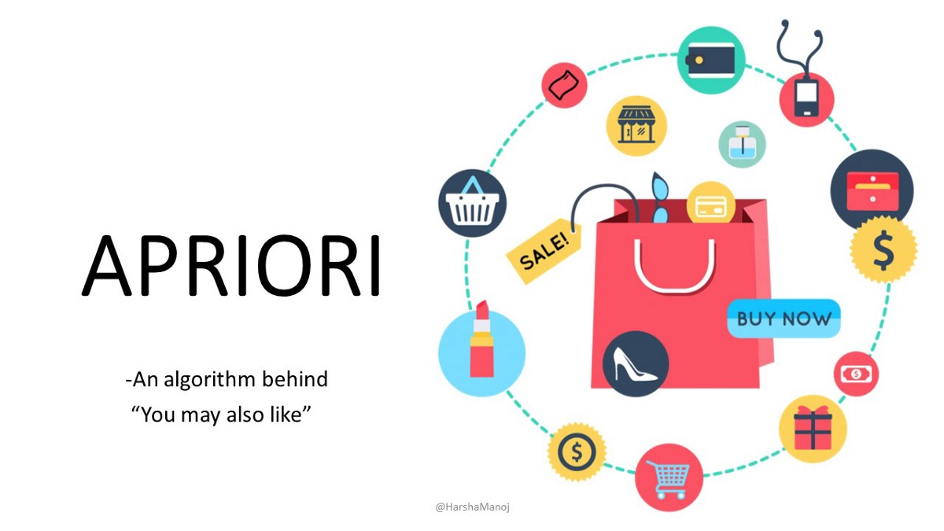

Slide 35
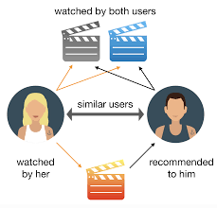
Personalized Recommendations

Slide 36

Hope you understand … what is web mining ….!!!!

Slide 37
Applications of Web Usage Mining
Electronic Commerce
design cross marketing strategies across products
evaluate promotional campaigns
target electronic ads and coupons at user groups based on their access patterns
predict user behavior based on previously learned rules and users’ profiles
present dynamic information to users based on their interests and profiles: “Web personalization”
Effective and Efficient Web Presence
determine the best way to structure the Web site
identify “weak links” for elimination or enhancement
prefetch files that are most likely to be accessed
enhance workgroup management & communication
Search Engines
Behavior-based ranking

Slide 38
Data Mining and Personalization
Personalization: “Killer App” for big data analytics
Tangible successes both in the research and in industrial applications
recommender systems
personalized Web agents
user adaptive systems
Web marketing & targeted advertising
personalized search
Sophisticated modeling approaches based on both predictive and unsupervised DM techniques

Slide 39
Web Mining
Web structure mining: discovers useful knowledge from hyperlinks
Web content mining
Web usage mining
data collection
Information Retrieval and Web Search
Indexing

Slide 40
Web Mining Use Cases
Social Network Analysis
PageRank and HITS
Web Crawling
universal crawlers and topic crawlers
Structured Data Extraction: Wrapper Generation
Information Integration
Opinion Mining and Sentiment Analysis

Slide 41
WWW !!!

Slide 42
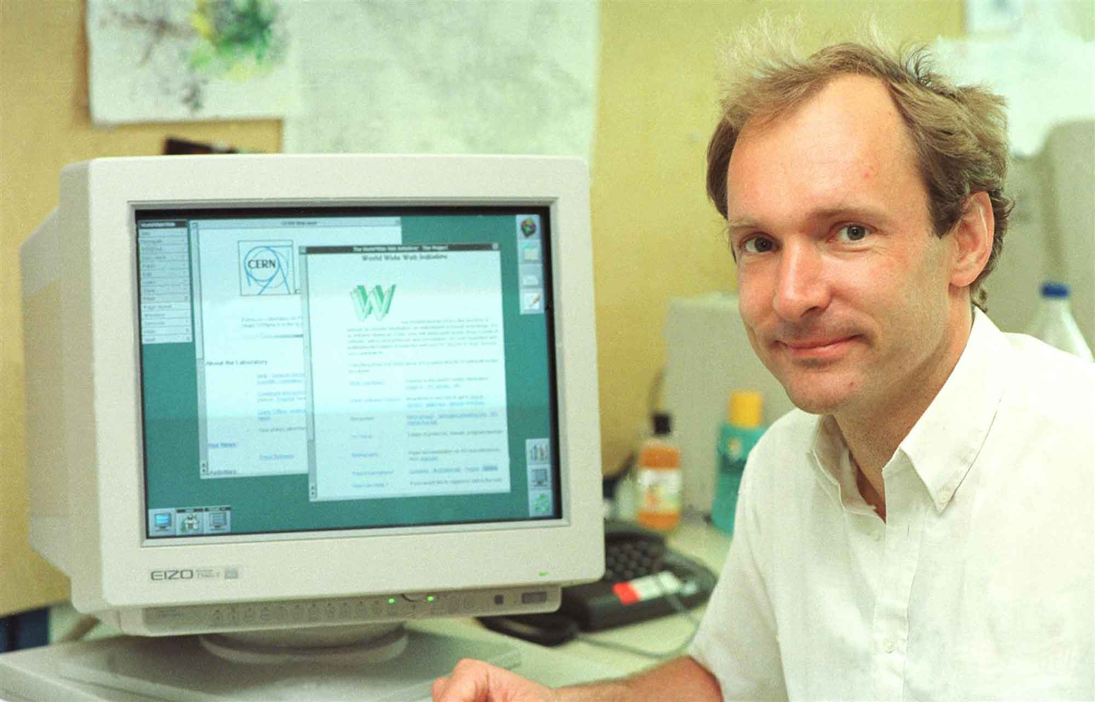
What is W3?
A broader definition comes from the organization that Web inventor Tim Berners-Lee helped found, the World Wide Web Consortium (W3C).

Slide 43

W3
WWW stands for World Wide Web. A technical definition of the World Wide Web is : all the resources and users on the Internet that are using the Hypertext Transfer Protocol (HTTP).
The WWW is a project was initiated by CERN (Council of European library for Nuclear Research) in 1989.
In simple terms, The World Wide Web is a way of exchanging information between computers on the Internet, tying them together into a vast collection of interactive multimedia resources.

Slide 44
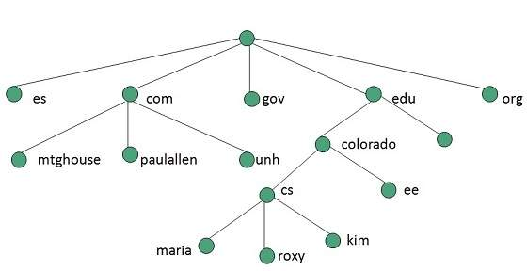
www

Slide 45
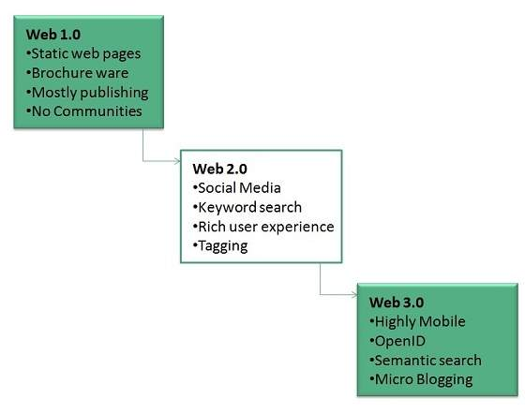
WWW Evolution
World Wide Web was created by Timothy Berners Lee in 1989 at CERN in Geneva. World Wide Web came into existence as a proposal by him, to allow researchers to work together effectively and efficiently at CERN. Eventually it became World Wide Web.
The following diagram briefly defines evolution of World Wide Web:

Slide 46
Components of Web

Slide 47
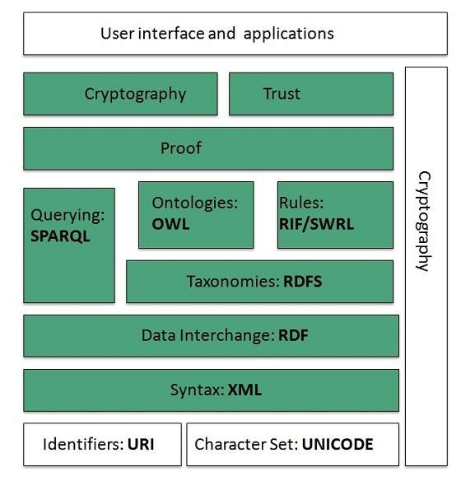
WWW Architecture
WWW architecture is divided into several layers as shown in the following diagram:

Slide 48
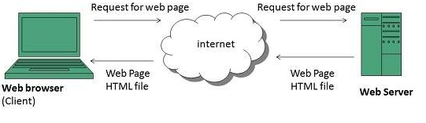
WWW Operation
WWW works on client- server approach. Following steps explains how the web works:
User enters the URL (say, http://www.vit.ac.in) of the web page in the address bar of web browser.
Then browser requests the Domain Name Server for the IP address corresponding to www.tutorialspoint.com.
After receiving IP address, browser sends the request for web page to the web server using HTTP protocol which specifies the way the browser and web server communicates.
Then web server receives request using HTTP protocol and checks its search for the requested web page. If found it returns it back to the web browser and close the HTTP connection.
Now the web browser receives the web page, It interprets it and display the contents of web page in web browser’s window.

Slide 49
Ontology – Semantic Web

Slide 50
Linked Life Data
Linked Life Data is used as a platform for Interactive Relationship Discovery between biomedical entities as it:
integrates over 25 diverse data sources;
aligns the data to more than 17 different biomedical objects (genes, proteins, molecular functions, biological processes/pathways, molecular interactions, cell localization, organisms, organs/tissues, cell lines, cell types, diseases, symptoms, drugs, drug side effects, small chemical compounds, clinical trials, scientific publications, etc.);
identifies explicit relationships between entities locked in the original data sets and categorizes them to a causality relationship ontology;
mines unstructured data in order to identify relationships hidden within the text (inclusion/exclusion criteria for clinical studies).

Slide 51
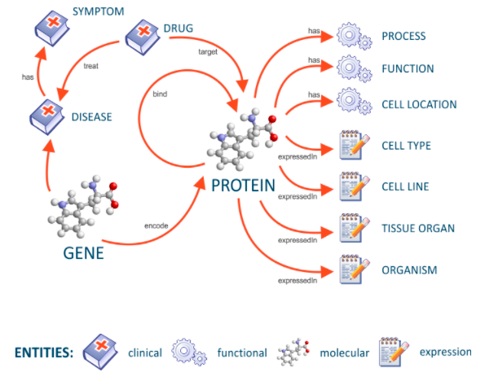
Linked Life Data Cloud
Semantic warehousing helps researchers get an overview of the existing relationships within scientific and clinical data by utilizing causality data mining.

Slide 52
Resource Description Framework (RDF) framework helps in defining core representation of data for web. RDF represents data about resource in graph form.
Taxonomies
RDF Schema (RDFS) allows more standardized description of taxonomies and other ontological constructs.
Ontologies
Web Ontology Language (OWL) offers more constructs over RDFS. It comes in following three versions:
OWL Lite for taxonomies and simple constraints.
OWL DL for full description logic support.
OWL for more syntactic freedom of RDF

Slide 53
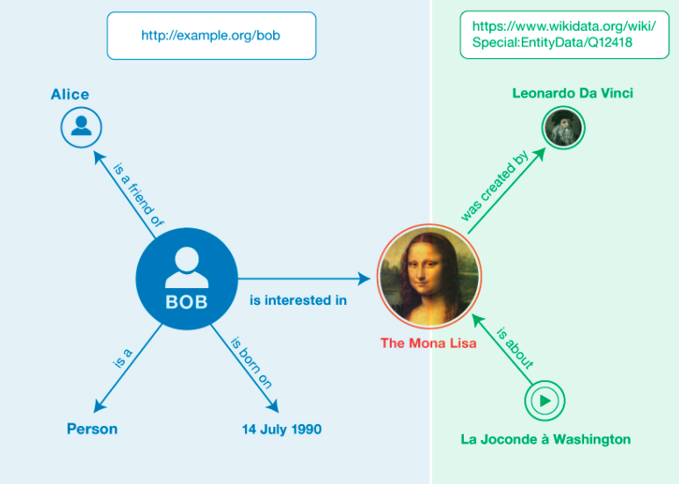

Slide 54
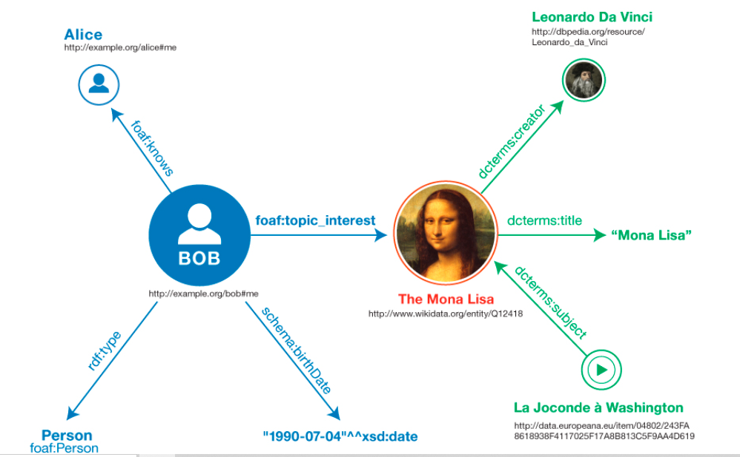
RDF

Slide 55
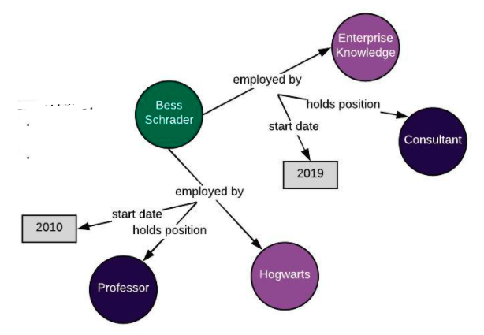
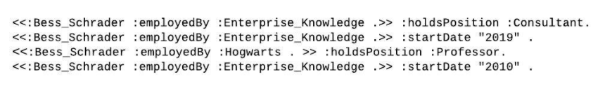
RDF

Slide 56
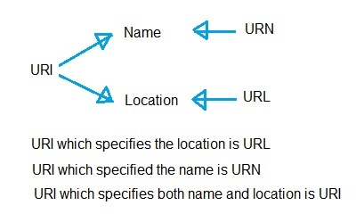

Slide 57
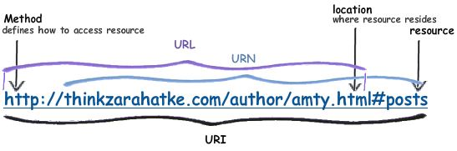

Slide 58
Rules
RIF is the W3C Rule Interchange Format. It's an XML language for expressing rules which computers can execute.
Semantic Web Rule Language (SWRL)offers rules beyond the constructs that are available from RDFs and OWL. Simple Protocol and RDF Query Language (SPARQL) is SQL like language used for querying RDF data and OWL Ontologies.
Proof
All semantic and rules that are executed at layers below Proof and their result will be used to prove deductions.
Cryptography
Cryptography means such as digital signature for verification of the origin of sources is used.
User Interface and Applications
On the top of layer User interface and Applications layer is built for user interaction.

Slide 59
The Terminology of the Web

Slide 60
Protocol
A protocol is a convention for transmitting information between two or more agents
An agent is any thing capable of interacting via a protocol.
A payload is the information transmitted by a protocol
The Web is based on a client-server architecture, meaning that protocols take the form of a request for information and a response with information

Slide 61
Client
The client is defined as the agent that is requesting information and the server is defined as the agent that is responding to the request
In a protocol, an endpoint is any process that either requests or responds to a protocol, and so includes both client and servers.
The client is often called a user-agent since it is the user of the Web

Slide 62
HTTP
The main protocol in this exposition will be the HyperText Transfer Protocol (HTTP)
HTTP consists of sending a method, a request for a certain type of response from a useragent to the server, including information that may change the state of the server.
These methods have a list of headers that specify some information that may be used by the server to determine the response.

Slide 63
Request
The request is the method used by the agent and the headers, along with a blank line and an optional message body
The methods in HTTP are HEAD, GET, POST, PUT, DELETE, TRACE, OPTIONS, and CONNECT
The first part of an HTTP response from the server then consists of an HTTP status code which is one of a finite number of codes which gives the user-agent information about the server’s HTTP response itself

Slide 64
HTTP
After the status codes there is an HTTP entity which is “the information transferred as the payload of a request or response”
An HTTP response consists of the combination of the status code and the HTTP entity.
The formal languages that can be explicitly given in a response or request in HTTP are called content types.

Slide 65
A media type consists of a two-part scheme that separates the type and a subtype of an encoding, with a slash indicating the distinction

Slide 66
Information Encoding and Content
Information is whatever regularities held in common between a source and a receiver
Whether or not the information is preserved over time or space is due to the properties of a physical substrate known as the channel
The message is the physical thing that realizes the regularities of the information due to its local characteristics

Slide 67
Information Encoding and Content
an encoding is a set of precise regularities that can be realized by the message
the content of any information-bearing message is whatever is held in common between the source and the receiver as a result of the conveyance of a particular message
The relationship of an encoding to its content, is an interpretation

Slide 68
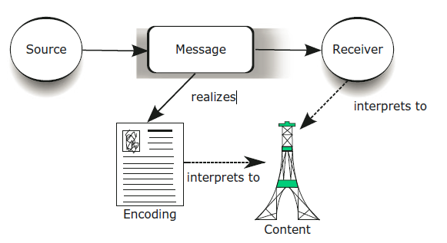
Information, encoding, content

Slide 69
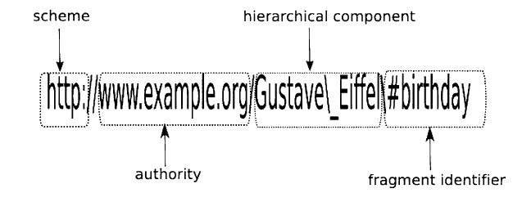
Uniform Resource Identifiers

Slide 70
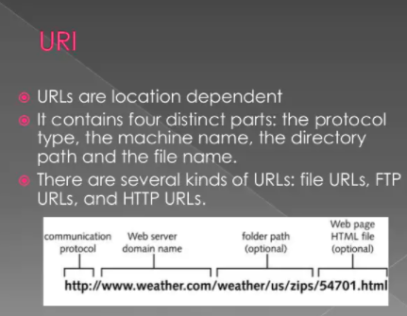

Slide 71
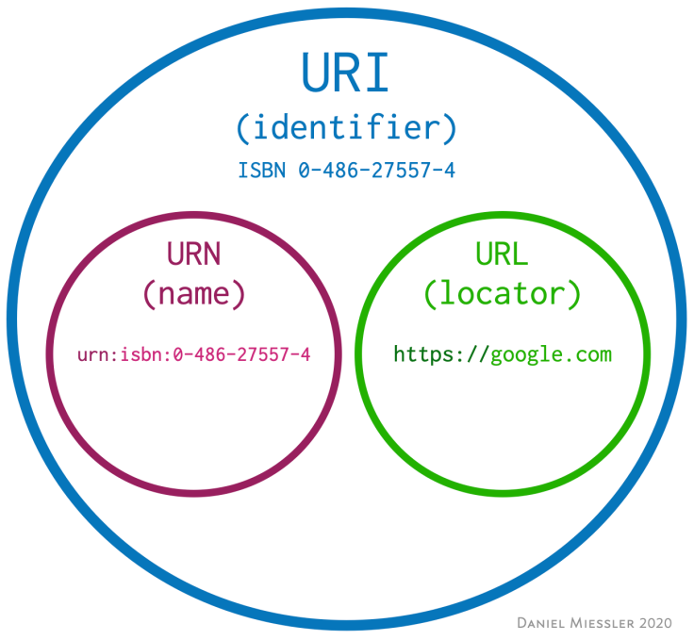
A URI is an identifier of a specific resource. Like a page, or book, or a document.
The most popular URI schemes, are HTTP, HTTPS, and FTP.
A URL is special type of identifier that also tells you how to access it, such as HTTPs, FTP, etc.—like https://www.google.com
A Uniform Resource Name (URN) is a Uniform Resource Identifier (URI) that uses the URN scheme, and does not imply availability of the identified resource. Both URNs (names) and URLs (locators) are URIs, and a particular URI may be both a name and a locator at the same time.

Slide 74
Resources
A resource is any thing capable of being content different agents create multiple URIs for the same content, which are then called in Web architecture co-referential URIs.

Slide 75
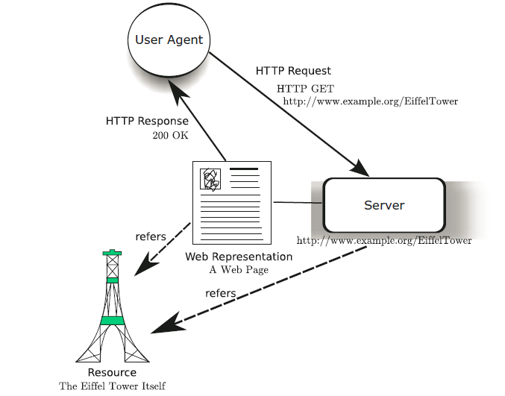
A user agent accessing a resource

Slide 76
Content Negotiation
Content Negotiation is a mechanism defined in a protocol that makes it possible to respond to a request with different Web representations of the same resource depending on the preference of the user-agent

Slide 77
Web Document Representation
Web representation is the encoding of the content given by a resource given in response to a request that is subject to content negotiation

Slide 78
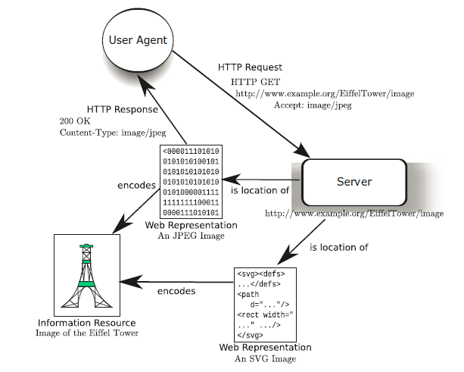
A user agent accessing a resource using content negotiation

Slide 79
Digitallity
Any information is digital when the boundaries in a particular encoding can converge with a regularity in a physical realization

Slide 80
Representations
Any encoding of information that has distal content is called a representation
Things that are separated by time and space are digital while those things that are not separated by time and space are proximal

Slide 81
The Principles of Web Architecture
The Principle of Universality can be defined as any resource that can be identified by a URI
A scheme for locations that allowed user-agents via an Internet protocol to access information was called Uniform Resource Locations (URLs) while a scheme whose names could refer to things outside of the causal reach of the Internet was called Uniform Resource Names (URNs)

Slide 82
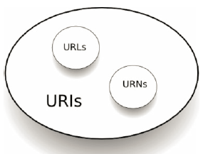

Slide 83
Linking Web Pages
The Principle of Linking states that any resource can be linked to another resource identified by a URI
Principle of Self Description states that the information an agent needs in order to have an interpretation of a Web Representation (resource) should be accessible from the Web representation itself (URI)

Slide 84
Web Principles
The Open World Principle states that the number of resources on the Web can always increase.
The Principle of Least Power states that a Web representation given by a resource should be described in the least powerful but adequate language

Slide 85




The Overview of Web Search Engines
Dr. Bhuvaneswari A

Slide 86
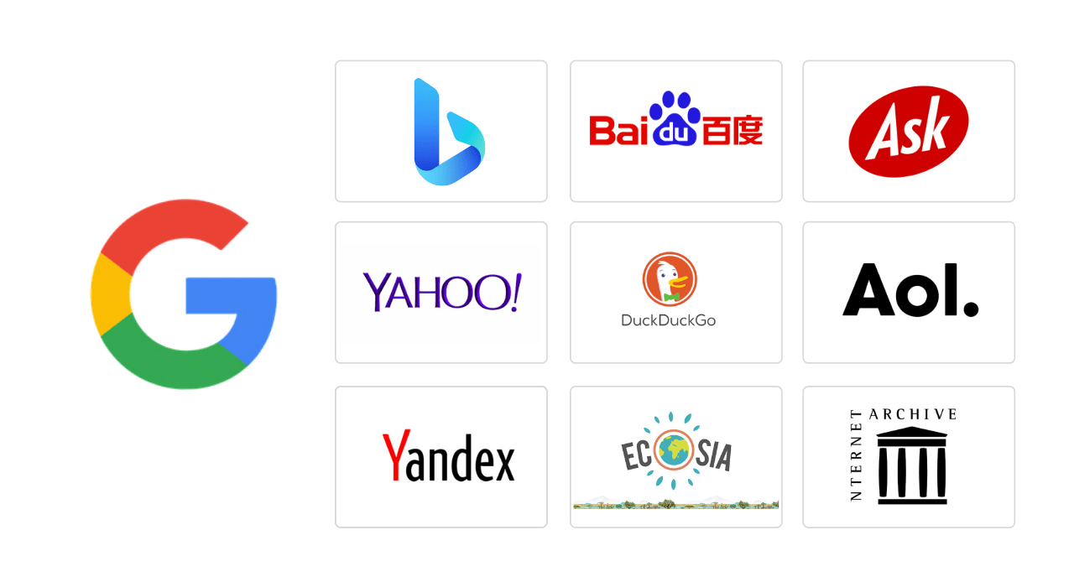
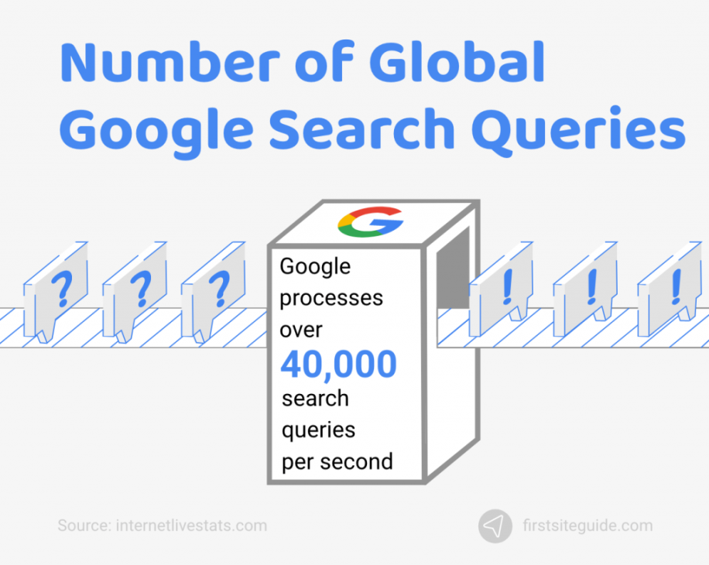
Questions about the Web
Q: How many computers are in the world? A: Over 40 million.
Q: How many of them are Web servers? A: Over 3 million.
Q: How many Web pages in the world? A: Over 350 million.
Q: What is the most popular formats of Web documents? A: HTML, GIF, JPG, ASCII files, Postscript and ASP.
Q: What is the average size of Web document? A: Mean: 5 Kb; Median: 2 Kb.
Q: How many queries does a search engine answer every day? A: Tens of millions.

Slide 87
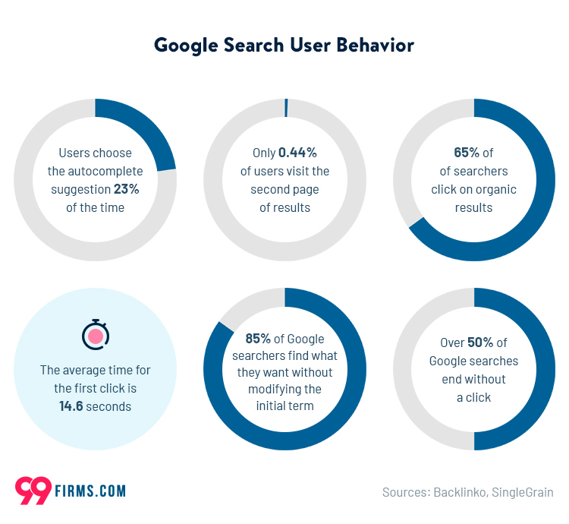

Slide 88
Characteristics of the Web
Huge (1.75 terabytes of text)
Allow people to share information globally and freely
Hides the detail of communication protocols, machine locations, and operating systems
Data are unstructured Exponential growth
Increasingly commercial over time (1.5 % .com in 1993 to 60% .com in 1997)

Slide 89
Difficulties of Building a Search Engine
Build by Companies and hide the technical detail Distributed data
High percentage of volatile data Large volume
Unstructured and redundant data Quality of data
Heterogeneous data Dynamic data
How to specify a query from the user
How to interpret the answer provided by the system

Slide 90
Information Retrieval
Search Engine is in the field of IR
Searching authors, titles and subjects in library card catalogs or computers
Document classification and categorization, user interfaces, data visualization, filtering
Should easily retrieve interested information
IR can be inaccurate as long as the error is insignificant
Data is usually natural language text, which is not always well structured and could be semantically ambiguous
Goal: To retrieve all the documents which are relevant to a query while retrieving as few non-relevant documents as possible

Slide 91
User Problems
Do not exactly understand how to provide a sequence of words for the search
Not aware of the input requirement of the search engine.
Problems understanding Boolean logic, so the users cannot use advanced search
Novice users do not know how to start using a search engine
Do not care about advertisements ? No funding
Around 85% of users only look at the first page of the result, so relevant answers might be skipped

Slide 92
Searching Guidelines
Specify the words clearly (+, -)
Use Advanced Search when necessary Provide as many particular terms as possible
If looking for a company, institution, or organization, try: www.name [.com | .edu | .org | .gov | country code]
Some searching engine specialize in some areas
If the user use broad queries, try to use Web directories as starting points
The user should notice that anyone can publish data on the Web, so information that they get from search engines might not be accurate.

Slide 93
Types of Search Engines
Search by Keywords (e.g. AltaVista, Excite, Google, and Northern Light)
Search by categories (e.g. Yahoo!) Specialize in other languages (e.g. Chinese Yahoo! and Yahoo! Japan)
Interview simulation (e.g. Ask Jeeves!)

Slide 94
The Largest Search Engines
(1998)
Search engine | URL | Web pages indexed
AltaVista | www. altavista.com | 140
AOL Search | search.aol.com | N/A
Excite | www.excite.com | 55
Google | google.stanford.edu | 25
GoTo | goto.com | N/A
HotBot | www. hotbot.com | 110
Go | www.go.com | 30
Lycos | www. lycos.com | 30
Magellan | magellan.excite.com | 55
Microsoft | search.msn.com | N/A
Northern Light | www. northernlight.com | 67
Open Text | www.opentext.com | N/A
WebCrawler | www. webcrawler.com | 2

Slide 95
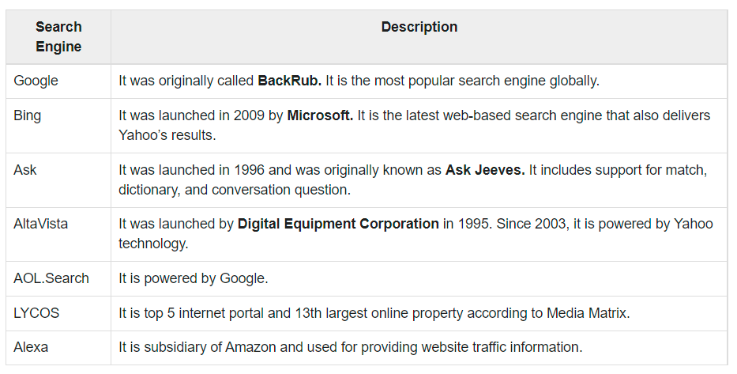

Slide 96
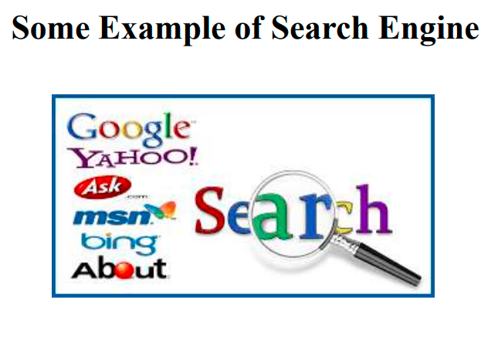

Slide 97
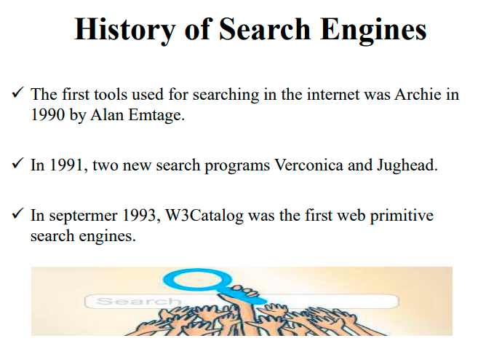

Slide 98
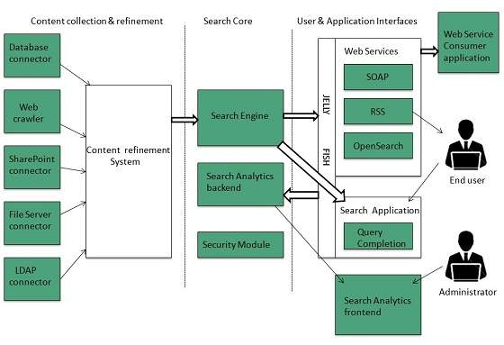
Search Engines Architecture
The search engine architecture comprises of the three basic layers listed below:
Content collection and refinement.
Search core
User and application interfaces

Slide 99
Search Engine Processing
Index Creation
It takes index terms created by text transformations and create data structures to suport fast searching.
Query Process
Query process comprises of the following three tasks:
User interaction, Ranking, Evaluation
User interaction
It supporst creation and refinement of user query and displays the results.
Ranking
It uses query and indexes to create ranked list of documents.
Evaluation
It monitors and measures the effectiveness and efficiency. It is done offline.
Indexing Process
Indexing process comprises of the following three tasks:
Text acquisition
Text transformation
Index creation
Text acquisition
It identifies and stores documents for indexing.
Text Transformation
It transforms document into index terms or features.

Slide 100
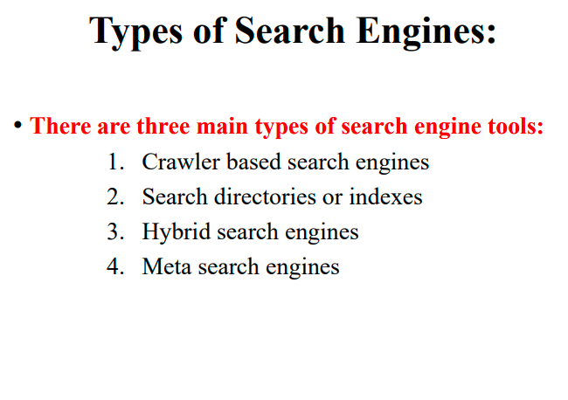

Slide 101
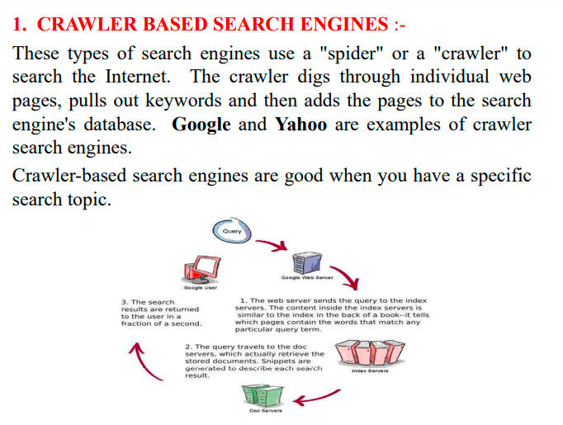

Slide 102
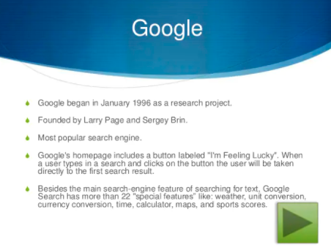

Slide 103


Slide 104


Slide 105



Slide 106


Slide 107


Slide 108


Slide 109


Slide 110


Slide 111


Slide 112
Search Engine Architectures
AltaVista Harvest Google

Slide 113
AltaVista Architecture
Index
Query Engine
Interface
Indexer
User
Crawler
Web

Slide 114
Harvest Architecture
Replication Manager
Broker
User
Broker
Gatherer
Object Cache
Web site

Slide 115

Google Architecture

Slide 116


Slide 117


Slide 118
User Interfaces
Query Interface
A box is entered a sequence of words (AltaVista uses union, HotBot uses intersection)
Complex query interfaces (e.g. Boolean logic, phrase search, title search, URL search, date range search, data type search)
Answer Interface
Relevant pages appear on the top of the list
Each entry in the list includes a title of the page, an URL, a brief summary, a size , a date and a written language

Slide 119
Web Directories
Also called: catalogs, yellow pages, subject directories
Hierarchical taxonomies that classify human knowledge
First level of taxonomies range from 12 to 26 Popularities: Yahoo!, eBLAST, LookSmart, Magellan, and Nacho.
Most allow keyword searches
Category services: AltaVista Categories, AOL Netfind, Excite Channels, HotBot, Infoseek, Lycos Subjects, and WebCrawler Select.

Slide 120
The Most Popular Web Directories in 1998
Web directory | URL | Number of Web sites | Categories
eBLAST | www.eblast.com | 125 | N/A
LookSmart | www.looksmart.com | 300 | 24
Lycos Subjects | www. lycos.com | 50 | N/A
Magellan | magellan.excite.com | 60 | N/A
NewHoo | www. newhoo.com | 100 | 23
Netscape | search. netscape.com | N/A | N/A
Search.com | www.search.com | N/A | N/A
Snap | www.snap.com | N/A | N/A
Yahoo! | www.yahoo.com | 750 | N/A

Slide 121
Ranking
Not publicly available
Do not allow access to the text, but only indices
Sometimes too many relevant pages for a simple query
Hard to compare the quality of ranking for two search engines
PageRank, Anchor Text

Slide 122
PageRank
Used by WebQuery and Google Google simulates users using the search engine to rank documents
Google uses citation graph (518 million links) Google computes 26 million in a few hours
Many pages point to the result page ? High ranking
Some high-ranking pages point to the result page ?
High ranking

Slide 123
Anchor Text
Most search engines associate the text of a link with the page that the link is on
Google is the other way around
Advantages: more accurate descriptions of Web pages and document can be indexed 259 million anchors
Idea was originated by WWWW (World Wide Web Worm)

Slide 124
Other Features
Keep track of location information for all hits
Keep track of visual presentation (e.g. font size of words)

Slide 125
Web Crawlers
Software agents that traverse the Web sending new or updated pages to a main server where they are indexed
Also called robots, spiders, worms, wanders, walkers, and knowbots
The 1st crawler, Wanderer was developed in 1993 Not been publicly described
Runs on local machine and send requests to remote Web servers
Most fragile application
Breath-first and depth-first manner Avoid crawling same pages
Web pages change dynamically Invalid links: 2% to 9%
Fastest crawlers are able to traverse up to 10 million pages per day

Slide 126
Google Crawler
Fast distributed crawling system How does it work?
Peak speed: > 100 pages/sec or 600k per sec for 4 crawlers
Use DNS cache to avoid DNS look up Each connection possible states:
Looking up DNS Connecting to host
Sending request Receiving response
Crawling problems

Slide 127
Internet Archive
Uses multiple machines
A crawler is a single thread Each crawler assigns to 64 sites
No site is assigned to more than one crawler
Each crawler reads a list of URLs into per-site queues
Each crawler uses asynchronous I/O to fetch pages from these queues in parallel
Each crawler extracts the links inside the downloaded page
The crawler assigns links to appropriate site queues

